Slide 1



MARKETING PLAN
“Why We Should Discontinue Ad Campaign #3 & #10
By group:
The Brainiacs

Slide 2


The Brainiacs
TEAM MEMBERS
Yugandhar Umale
Suryanshi Kuyate
Aditya Tiwari
Ritika Mhatre
Aditi Kharate
Ayush Paunikar

Slide 3
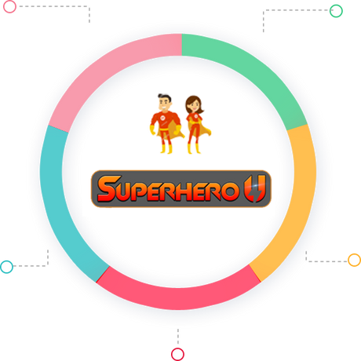









Superhero U
Superhero U was an endeavor to empower imaginative and fervent young minds to make the best possible use of their skills and creativity.
Influenced by the UN's 17 sustainable development goals, these goals were broadly categorized into 5 themes:
People
Peace
Planet
Partnerships
Prosperity

Slide 4





The competition proved to be an exciting assessment of the ingenuity and intellect of the participants.
Imagine
Illustrate
Innovate
Inspire
The competitors joined ‘Superhero U’ as individuals or in teams. Divided into the high school and college categories, ‘Superhero U’ was conducted in three rounds
Preliminary
Rounds
Semi-final
Rounds
Final
Rounds
August 2020
April 2021

Slide 5


FACEBOOK ADS
Facebook Ads is an online advertising platform provided by Facebook, one of the largest social media networks.
It enables businesses and individuals to create and manage targeted advertisements that reach specific audiences on Facebook and its affiliated platforms, such as Instagram and Messenger.

Slide 6


Here's a brief explanation of how Facebook Ads work
Objective Setting
Ad Format Selection
Ad Creation
FACEBOOK ADS
Ad Monitoring and Optimization
Ad Placement and Budgeting
Audience Targeting

Slide 7



OVERVIEW OF AD CAMPAIGNS
11 Superhero U ad campaigns
WHERE
WHO
HOW
Australia
Canda
Ghana
India
Nepal
Nigeria
UAE
UK
USA
Reach
Impressions
Unique Clicks
Click-Through Rate
Cost Per Click
Cost per Result
Students
Educators & Principals

Slide 8
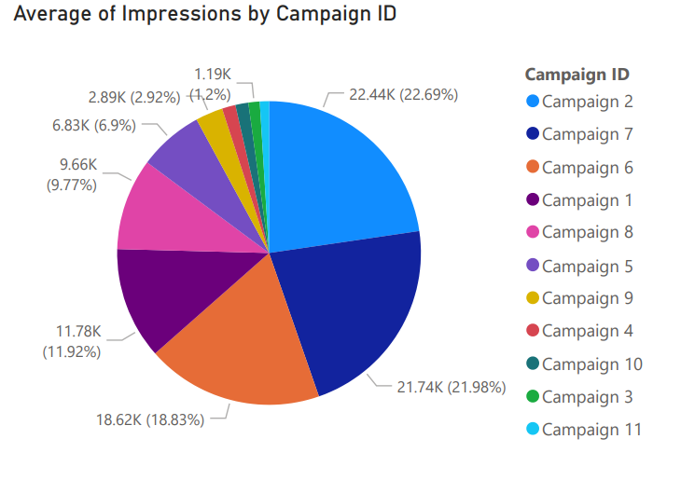
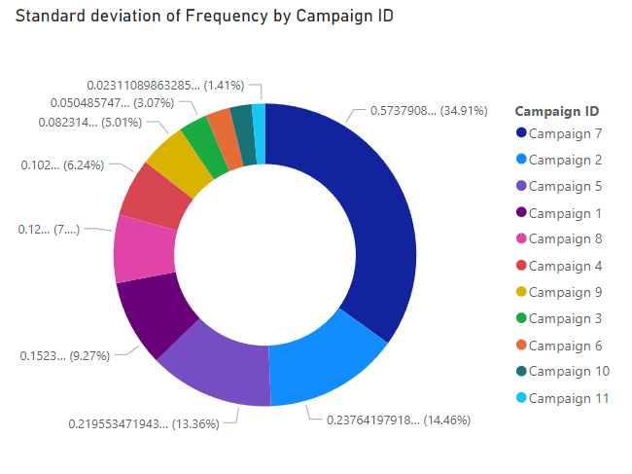
COMPARISON OF CAMPAIGNS

Slide 9
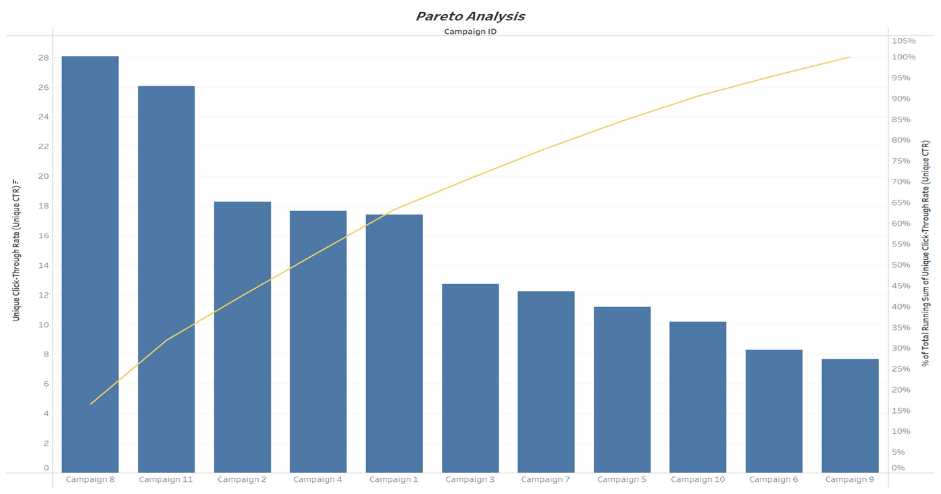
MORE VISUALS
Pareto analysis (80/20 rule) indicates about 80% of the effects come from 20% of the causes.
Campaigns 8 & 11 = 20% of the total campaign
leads to 80% of Unique – CTR.

Slide 10
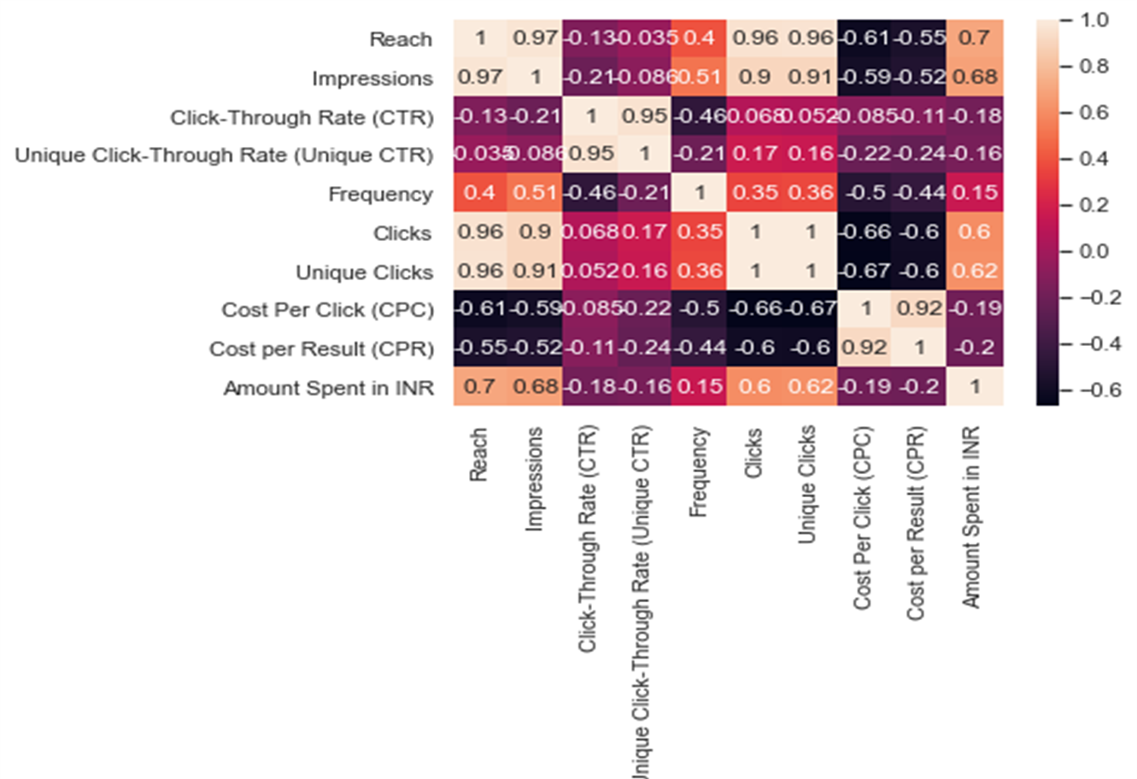
CORRELATION MATRIX
As Reach decreases, CPR increases by 55% as they have a negative correlation.
When Impression decreases, the CPR increases by 52% as they have a negative correlation.
When Clicks & Unique clicks decrease, the CPR again increases by 60% and vice-versa.
When the Frequency decreases, CPR increases by 44% and vice-versa.
When CTR & Unique CTR decreases, CPR increases and vice-versa.

Slide 11
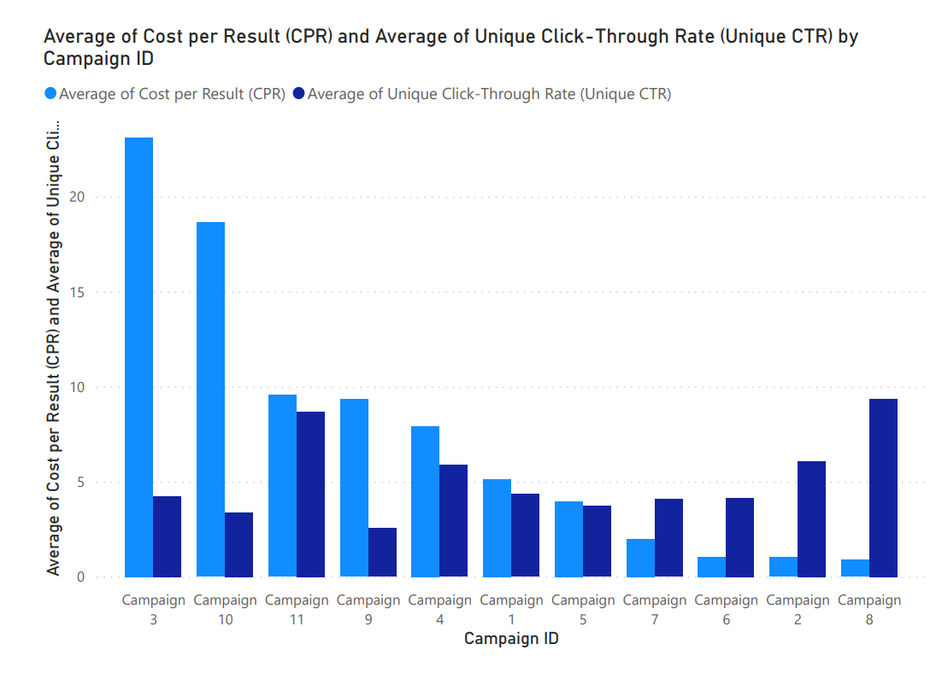


CAMPAIGNS TO BE DISCONTINUED
Campaign 3
Campaign 10
Australia
UK

Slide 12

CONCLUSION
We analyzed the data using different visualizations of the scatterplot, bar chart, pie chart, and histogram using Microsoft Excel and Power BI.
The conclusion we reached is that Campaign - 3 and Campaign - 10 are the least efficient campaigns.
Campaign - 3 shows a negative output of results compared to the other campaigns. To improve this situation it is advised that we improve the marketing strategy in Australia and the UK.

